Slide 1
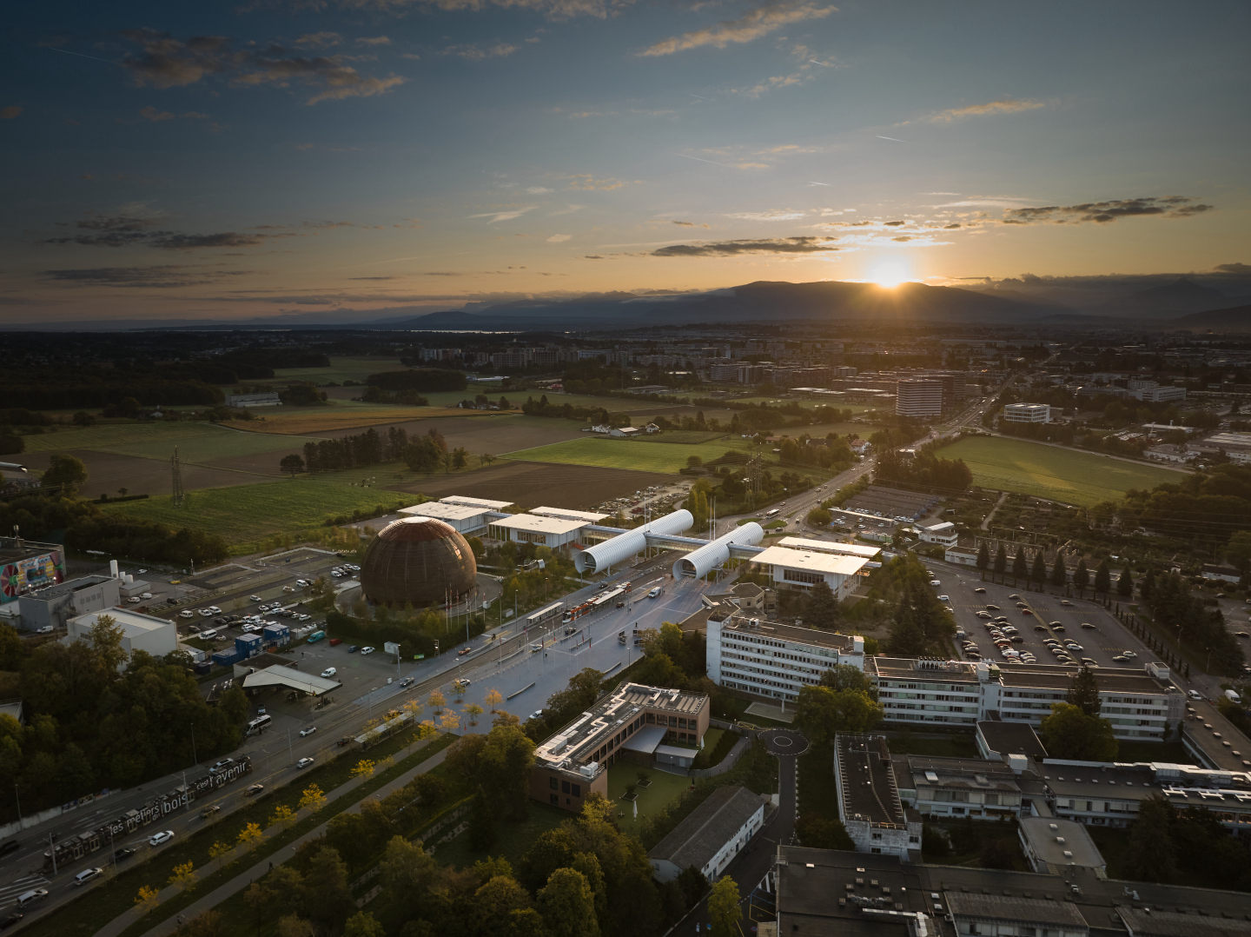
SCOAP³ Forum
18th June 2025
CERN, Geneva, Switzerland
Introduction and Logistics
Ianko Lopez, SCOAP³ forum Chair

Slide 2
Logistics for participants
This is a webinar-style session: only panelists can speak
Participants are welcome to ask any question in the Q&A form
The questions will be answered either in writing or by the panelists at the end of the presentations.
Please note that due to time contraints, we might not be able to answer all questions - when necessary, we will ensure to follow-up after the forum.
The record of the meeting and the slides will be made available online on the SCOAP³ website (https://scoap3.org)
2

Slide 3
Forum Agenda
09.00 – 09.10 1. Welcome and introduction by Forum Chair (Ianko Lopez, Consorcio Madroño, Spain)
09.10 – 09.30 2. SCOAP³ Phase 4 Contracts (Anne Gentil-Beccot, CERN)
09.30 – 09.40 3. Results of the first evaluation (Pia Kretschmar, CERN)
09.40 – 09.55 4. A SCOAP³ partner perspective (Anna Vernon and Charles Brophy, JISC, UK)
09.55 – 10.05 5. Crossref’s perspective (Kornelia Korzec, Crossref)
10.05 – 10.30 6. Q&A

