Slide 1
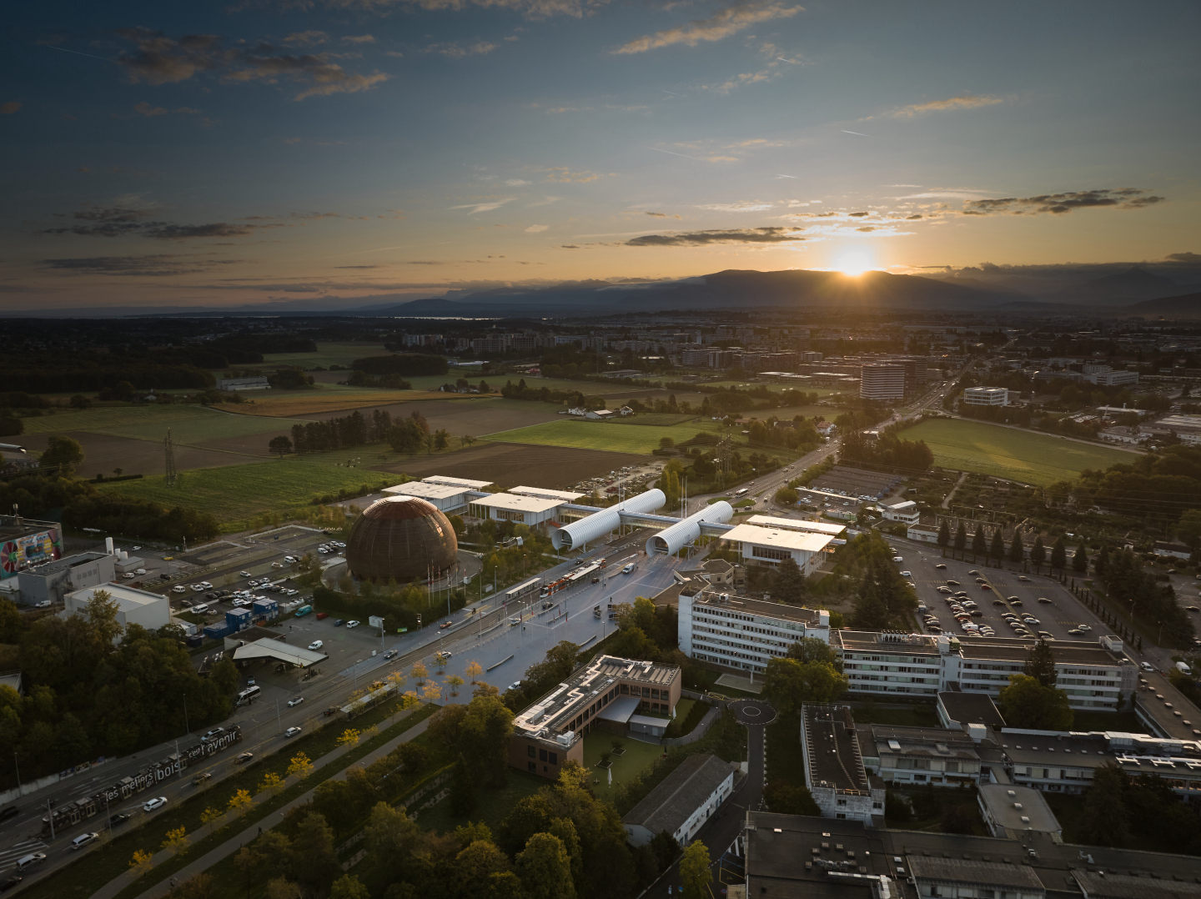
SCOAP³ Forum
18th June 2025
CERN, Geneva, Switzerland
SCOAP³: Phase 4 and OS elements
Anne Gentil-Beccot, CERN SCOAP³ team

Slide 2
What is SCOAP³?
Sponsoring Consortium for Open Access Publishing in Particle Physics
Mission:
  SCOAP³ enables open access publishing in the field of high-energy physics, helping to remove financial and administrative barriers to science
International collaboration launched in 2014
Partnership consisting of 3000+ libraries, research institutions and international research organizations from 47 countries (and growing)
11 of the leading journals in the discipline of high energy physics
Notes:
So what is SCOAP3? It is the largest open access collaboration in the world. It’s de-facto one of the first diamond models as it allows for everbody to publish at no cost or any other barriers in the 11 participationg journals immediate open access, centrally paid by SCOAP3.

Slide 3
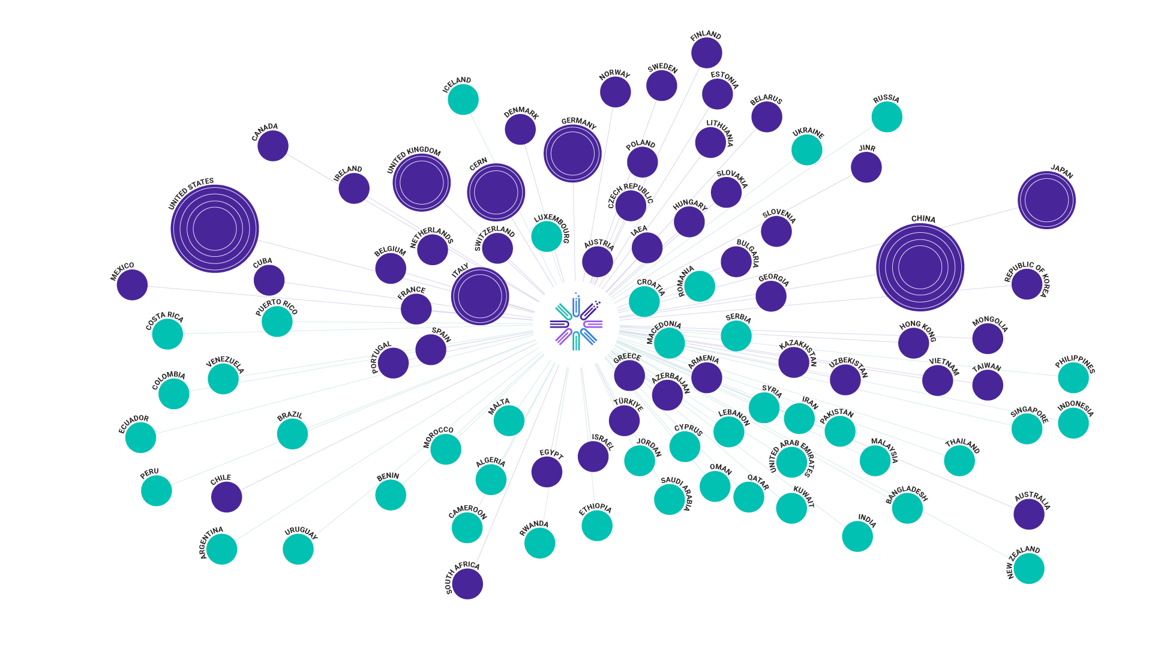
Global partners
Partners in the SCOAP³ collaboration
Countries/Regions/Territories with at least one SCOAP³ author
3

Slide 4










First 10 years (2014-2024): 75,004 articles funded (90+ % of all HEP )
Publisher | Journal | Articles
 | Physical Review C | 661
 | Physical Review D | 16,821
 | Physical Review Letters | 2,153
 | Nuclear Physics B | 3,629
 | Physics Letters B | 9,455
 | Advances in High Energy Physics | 1,135
 | Chinese Physics C | 896
 | New Journal of Physics | 25
 | J. Cosm. and Astroparticle Physics | 654
 | Acta Physica Polonica B | 179
 | Progress of Theor. and Experimental Physics | 994
 | European Physical Journal C | 11,495
 | Journal of High Energy Physics | 26,907
Joined in
2018
until
2017

Slide 5
Best-in-class value for money…
List price APCs of comparable journals
Effective cost per article for SCOAP³

Slide 6
…and stable prices for SCOAP³ partners
2013: 1
+54%
+38%
+34%
+29%
+24%
+7%

Slide 7
SCOAP³ commercial arrangements
Maximum Contract Values (CAP) and nominal APCs based on the initial 2012 SCOAP³ tender.
Actual number of articles x APC
Actual SCOAP³ payment
Maximum contract value (2012 tender)
Actual SCOAP³ payment
Maximum contract value (2012 tender)
Actual number of articles x APC
Example 1: Publisher publishes less than the Max contract value
Example 2: Publisher publishes more than the Max contract value

Slide 8
Phase 4 of SCOAP³: from Open Access to Open Science
Disciplinary OA has been achieved and sustained for a decade
Proceed with renegotiation of existing SCOAP³ contracts
Includes mechanism to financially incentivize publishers on delivery of Open Science Elements that situate publications in HEP more readily for OS future

Slide 9
New SCOAP3 commercial arrangements for Phase 4
Mechanism to financially incentivize publishers on delivery of Open Science Elements that situate publications in HEP more readily for OS future
  Adjustment of maximum contract value and nominal APCs
  Based on comparative scoring performance with other SCOAP³ publishers
  Pioneering OS elements leading to better service quality and innovative compensation mechanism
+ OS Elements
Actual SCOAP³ payment
Maximum contract value
- OS Elements
Actual SCOAP³ payment
+ OS Elements
Maximum contract value
- OS Elements
Actual number of articles x APC
Actual number of articles x APC
Example 1: Publisher gets a positive adjustment from the OS elements
Example 2: Publisher gets a negative adjustment from the OS elements

Slide 10
Open Science Elements
Open Science Elements | Definition
ORCID adoption | Integrate ORCiD submission for all (co)authors into the publishing process and ensure systematic distribution of ORCiDs in subsequent metadata feeds
ROR adoption | Integrate ROR submission for institutional identification into the publishing process and ensure systematic distribution of RORs in subsequent metadata feeds
Standardized metadata provision | Provide enriched article metadata in a consistent, standardized, community-determined format; include abstracts and references
Dataset Linking | Enabling linking between articles and related datasets; improve/incentivize publishing of data as supplementary material associated with publications
Software Linking | Enabling linking between articles and related research software; improve/ incentivize publishing of software as supplementary material associated with publications
Transparent Peer Review | Offer open or public peer-review services which provide both authors and reviewers options to publish peer-review reports
Accessibility | Removing barriers to accessing content for people with disabilities by following WCAG guidelines.
SCOAP³ Community Values Disclosures | Provide transparent statements on core business practices related to defined community values (see next slide)

Slide 11
Open Science Elements (cont’d)
Open Science Element | Values
SCOAP³ Community Values Disclosures | Diversity, Equity & Inclusion: in aspects ranging from the profile of authors/first-time submitters; diversity in career stages; geographical diversity (in publishing and editorial practices); gender equity; etc.
 | Sustainability: adopting practices to reduce their carbon emissions and address sustainability issues within their operations towards becoming net-zero businesses.
 | Data Privacy: adopting practices to protect the privacy of users consistent with the European Union’s General Data Protection Regulation (GDPR).
 | Financial Transparency: engaging in emerging price transparency frameworks.
 | Referee Recognition/Compensation: demonstrating transparency in how the work of referees is acknowledged/ recognized/compensated.
 | Publication transparency: publication of journal metrics such as acceptance rates and desk rejection rates

Slide 12
Operational implementation of OS Elements mechanism
Annual assessment by CERN using previous year information (max 31 points)
  Combination of automated and manual validation
  Average score if publisher participates with several journals
  Objection possibility for publishers
Calculation of average SCOAP³ Score, weighted by the number of SCOAP³ articles in previous year
Calculation of publisher adjustment
  Relative performance compared to average, capped at +/- 10%
  5% bonus if publisher scored at least 50% of the available 31 points to create a
  clear incentive for all publisher to invest into the needed infrastructure
New annual Maximum Contract Value and nominal APC adjusted accordingly for actual year (re-assessment in the following year)

Slide 13
Calculation
Journal score
Points attributed for all OS element meeting the contract’s requirements
Publisher’s score
Average of Journal scores of 1 publisher weighted by Nr of articles per Journal in the last 12 months
Bonus (5%)
If Publisher’s score is >16
Financial adjustment (max. +15%/-10%)
SCOAP³ score
Average of Publisher’s scores weighted by the Nr of articles per Journal in the last 12 months

Slide 14
Phase 4: increased investment for additional services
2013: 1
+73%
+51%
+32%
+16%

Slide 15
THANK YOU
Any Questions or Comments?
scoap3@cern.ch

