Slide 1
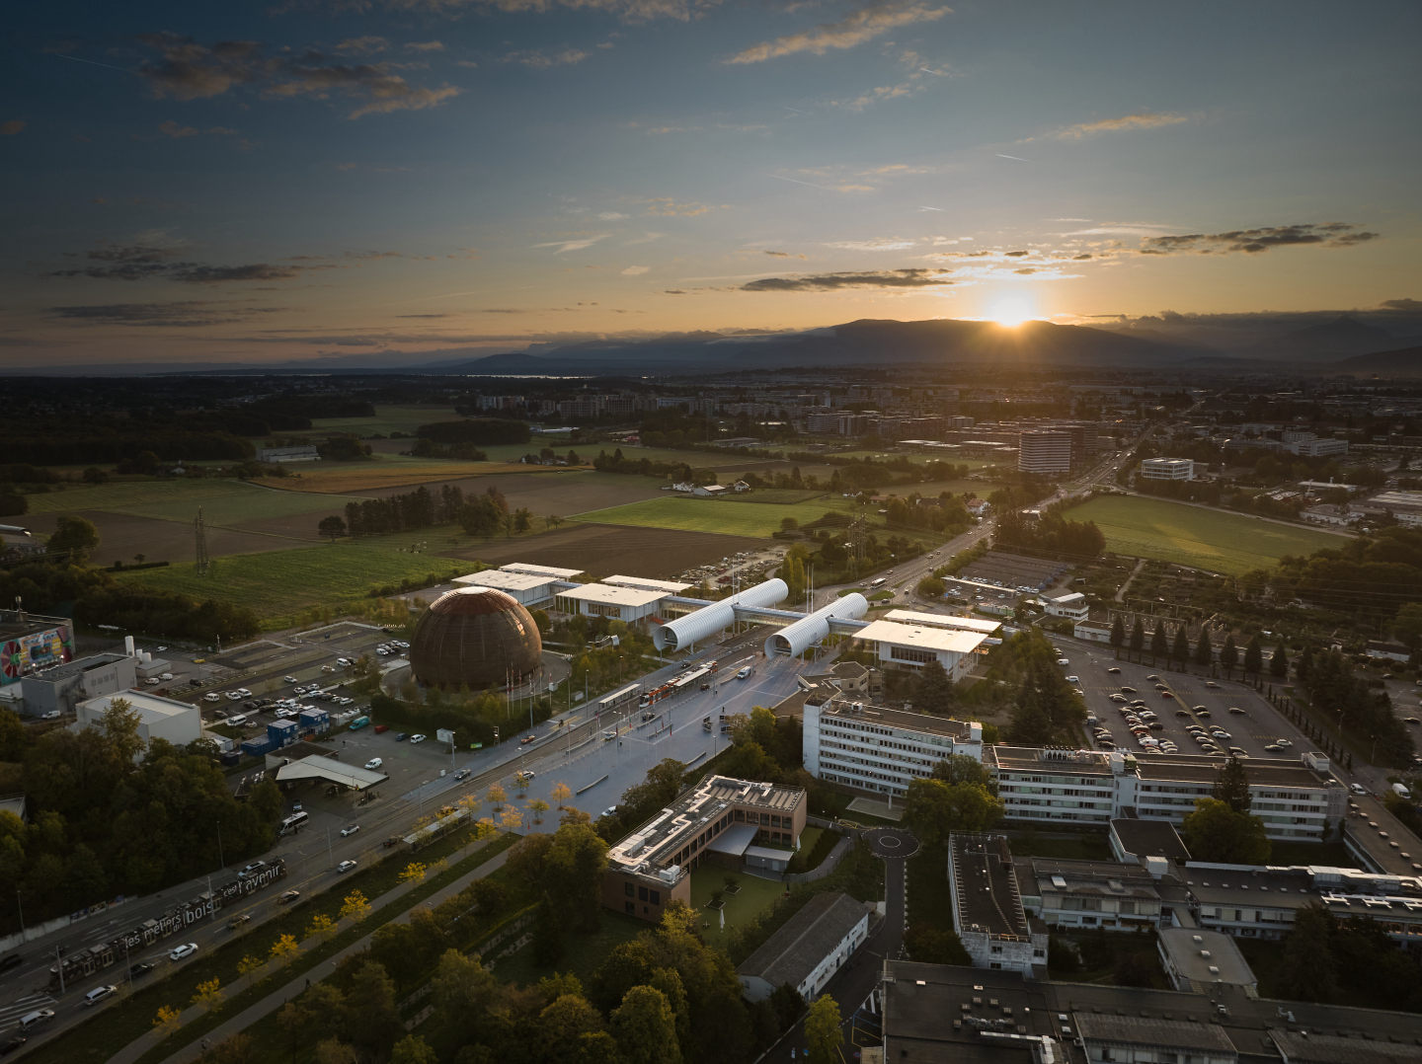
SCOAP³ Forum
18th June 2025
CERN, Geneva, Switzerland
1st evaluation of OS Elements for Phase 4
Pia Kretschmar, CERN SCOAP³ team

Slide 2

Outline
    Process and Methodology
    Results
    Takeaways & Future
18.06.2025 Pia Kretschmar

Slide 3
Process and Calculation
Annual evaluation of Open Science Elements for all SCOAP³ Journals
Journal score
Points attributed for all OS element meeting the contract’s requirements
Publisher’s score
Average of Journal scores of 1 publisher weighted by Nr of articles per Journal in the last 12 months
Bonus (5%)
If Publisher’s score
is >16
Financial adjustment (max. +15%/-10%)
SCOAP³ score
Average of Publisher’s scores weighted by the Nr of articles per Journal in the last 12 months
18.06.2025 Pia Kretschmar

Slide 4
Methodology
Sources:
  Analysis of metadata:
    From SCOAP3 Repository and CrossRef API (articles of the last 3 months of the previous year)
    2024 articles
  Information provided by the publishers from some elements
Calculation for every element based on the contract description
Source data and calculation shared with publishers for validation
Final score calculation, after validation from all publishers
18.06.2025 Pia Kretschmar

Slide 5
Results - by OS Element
OS Element | Max. Points in 2025 | Average Points | Source
ORCiD Integration | 5 | 2.63 | Presence of ORCiDs provided in evaluated set of articles; information about validation of ORCiD provided by publishers
ROR Integration | 2 | 1.68 | Presence of ROR provided in evaluated set of articles from Crossref and the Repository
Public Peer Review | 1 | 0 | Information provided by publishers
Dataset Linking | 2 | 1.97 | Information provided by publishers (further calculation on development of available dataset links will be done in 2026)
Software Linking | 2 | 1.97 | Information provided by publishers (further calculation on development of available software links will be done in 2026)
Depositing of detailed Metadata to Crossref | 6 | 2.17 | List of mandatory and additional fields.
Excellence in Accessibility | 4 | 1.98 | Information provided by publishers (i.e. VPAT certificate)
Disclosure on SCOAP³ Community Values | 3 | 3 | Information provided by publishers: transparency is evaluated not the actual compliance with the values
Total | 25 | 15.4
18.06.2025 Pia Kretschmar

Slide 6
Results by publisher
Can also be found at https://scoap3.org/journals-2025-2027/open-science-elements/
Publisher | Journal | Score 2025
APS | Pysical Review C (PRC) Physical Review D (PRD) Physical Review Letters (PRL) | 20.18
Elsevier | Nuclear Physics B (NPB) Physics Letters B (PLB) | 11.70
IOP | Chinese Physics C (CPC) | 8.00
Jagiellonian University | Acta Physica Polonica B (APPB) | 3.00
Oxford University Press | Progress of Theoretical and Experimental Physics (PTEP) | 5.00
Springer Nature | The European Physical Journal C (EPJC) The Journal of High Energy Physics (JHEP) | 13.33
Wiley | Advances in High Energy Physics (AHEP) | 7.00
SCOAP³ average |  | 15.41
18.06.2025 Pia Kretschmar

Slide 7
Takeaways & Future
Good performance for (almost) every publisher:
  Accessibility level AA of WACG standard
  Transparency via the community values
Areas of improvement:
  Persistent identifiers (ROR and ORCID)
  Metadata submitted to CrossRef
  Links to datasets and software
  More innovative OS practices (i.e. Open Peer-review)
Ongoing dialogue with publishers important
Next evaluation: January 2026
  Will include calculation on dataset and software linking (compared to 2025)
Overall objective: Create incentives to develop Open Science practices across
the portfolio
18.06.2025 Pia Kretschmar

Slide 8
THANK YOU
Any Questions or Comments?
scoap3@cern.ch

