Slide 1
SCOAP³ in the UK
Anna Vernon, Head of Research Licensing &
Charles Brophy, Licensing Manager

Slide 2
About Jisc
Jisc is a not-for-profit UK digital, data and technology agency focused on tertiary education, research and innovation.
We provide the Janet Network - the UK’s National research and education network (NREN)
Help the sector save time and money – through our sector wide deals and shared services alone we saved the sector £500m last year
Our work is developed in line with UK government, funding councils and research funders' policies including UKRI, Wellcome Trust

Slide 3
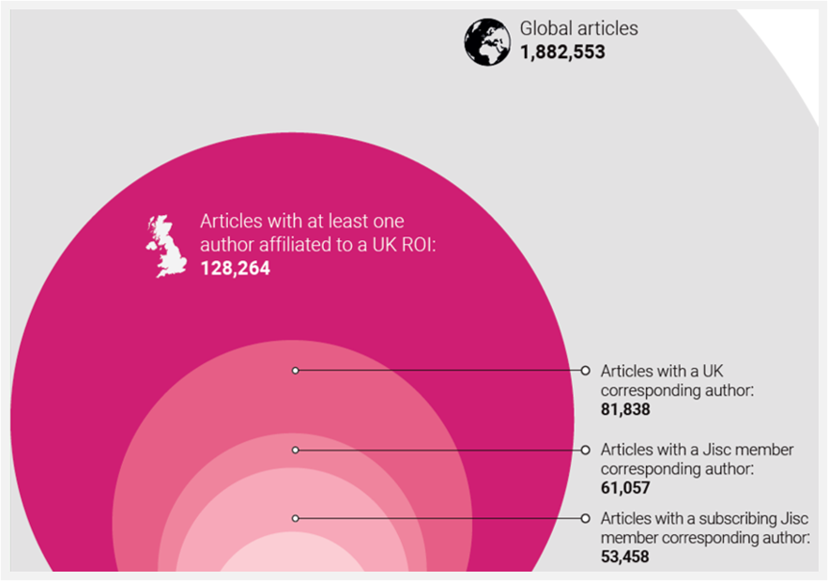
Our Role in Open Access
Jisc supports UK higher education to transition to open access by negotiating a range of agreements which include:
  Transitional agreements
  Fully open access agreements
  Compliant green agreements
We also facilitate agreements supporting a range of open infrastructures and not for profit initiatives: e.g. ArXiv, The Public Knowledge Project, OpenCitations, ORCID, Dspace, CORE, CLOCKSS and DOAJ.

Slide 4
UK involvement in SCOAP³
Jisc first joined SCOAP³ on behalf of UK HE institutions in 2008
I sit on the Governing Council
Jisc also participates in SCOAP³ for Books
The UK’s SCOAP³ contribution is co-financed by STFC/UKRI
In recent years ~50 UK higher education institutions have contributed annually
Changing share of UK’s global authorship:
Phase 2: 6.2%
Phase 3: 5.2%
Phase 4: 5.3%

Slide 5

Next Generation Open Access
2024 – Review of Transitional Agreements
2025 – Next Generation Open Access initiative
Aim 1: Support institutions in responding to the financial crisis
Aim 2: Enable more inclusive participation in open research
Slow progress to full open access
Closed publishing remains strong
Growth in hybrid articles

Slide 6
“How Equitable Is It?”
“How Equitable Is It?” (HEII) tool launched in May 2025.
We are using HEII to assess all agreements from 2025
Assesses publishing models across 7 key criteria:
  Access to Read
  Publishing immediate Open Access
  Maximizing participation
  Re-use rights
  Pricing and fee transparency
  Open research practices: data and code
  Open research practices: preprints and open peer review
Used in our communications materials

Slide 7
How Equitable Is SCOAP³?
Category | Score | Comments/Rationale
Access to read | 5/5 | All content is freely available to read as Open Access.
Publishing immediate open access | 5/5 | Any researcher can publish free of charge. No requirement for the author or their home institution to have a publishing agreement in place.
Maximizing participation | 5/5 | Pricing for individual institutions and SCOAP3 as a whole is not based on APCs. No limits on number of articles/outputs per participating institution. The service uses more than one factor to determine the eligibility to participate (e.g. not just the affiliation of the corresponding author). Contributions from both institutions that publish and those that can be considered “read only” are actively sought.
Re-use rights | 5/5 | The funding flow supports the ability for anyone to download all content without any restrictions and reuse it any way they choose, subject to the norms of academic attribution. Authors are presented with language or licence terms that respect their original licence choice and/or prior rights on their manuscript.
Pricing and fee transparency | 5/5 | Fees or contributions charged are publicly disclosed. The rationale for the calculation of the fee/contribution and any subsequent increases or changes is transparent and comprehensible.
Promoting and encouraging open research practices: data and code | 5/5 | SCOAP3 Phase 4 is incentivising publishers with additional funding to include dataset linking, improving the availability of data as supplementary material and enabling software linking in all articles.
Promoting and encouraging open research practices: preprints, preprint review and open identifiers | 3/5 | The publisher/service provider uses open (non-proprietary) identifiers. Additional funding to incentivise publishers to adopt ORCID and ROR standards.
Overall | 33/35 | Highly equitable.

Slide 8

Challenges
Financial context of UK HE:
  73% of libraries across UK HE are making cuts to their budgets this academic year.
  The average cut is 8.2%. Cuts range from less than 1% (0.6%) to 30% of total budget.
As a result, we may see a reduction in support for open infrastructure agreements.
In response, Jisc is launching a new Equity Contribution option with the aim of encouraging more institutions to contribute what they can to SCOAP³.

Slide 9
Using SCOAP³ in Jisc Negotiations
Alongside involvement in SCOAP³, we also have agreements with most SCOAP³ publishers.
SCOAP³’s new Open Science Mechanism can complement the use of the “How Equitable Is It?” tool to assess publisher models
SCOAP³ assessments can also help us & publishers evidence progress towards Open Science in communication with our members

