Slide 1

Strides towards the Research Nexus
June 2025
Kora Korzec

Slide 2

What is Crossref?
22,300 organisational members from 160 countries
  50% of members are based in Asia
  40% of members are universities or scholar-led
128 Sponsor orgs; 48 Ambassadors
170 million open metadata records with DOIs
1.3 billion resolutions per month (94% of all DOI usage)
2 billion queries of our metadata every month by 0000s (?) systems ingesting and reusing this open metadata
Notes:
We’re a not-for-profit membership organisation that exists to make scholarly communications better.

Slide 3
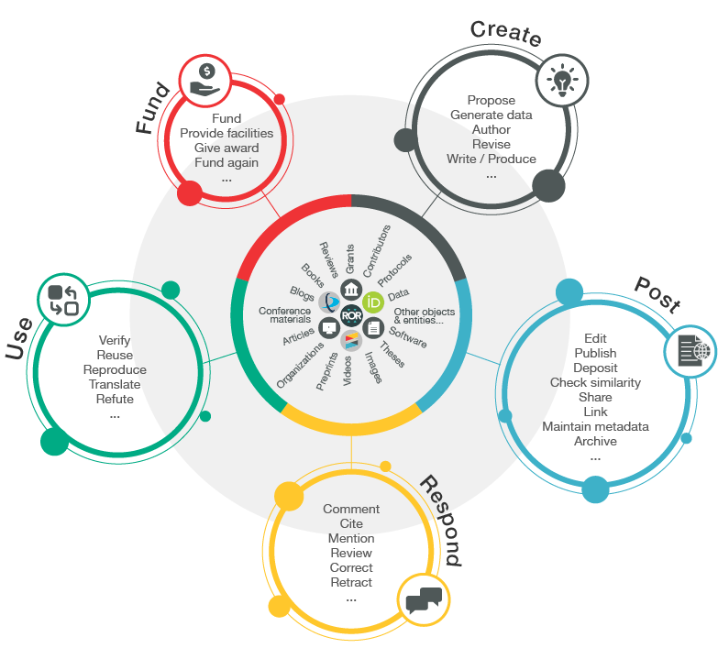
Research Nexus Vision
Like others… we envision
“a rich and reusable open network of relationships connecting research organizations, people, things, and actions; a scholarly record that the global community can build on forever, for the benefit of society."
Metadata is the thread that
is woven to produce such
a network

Slide 4
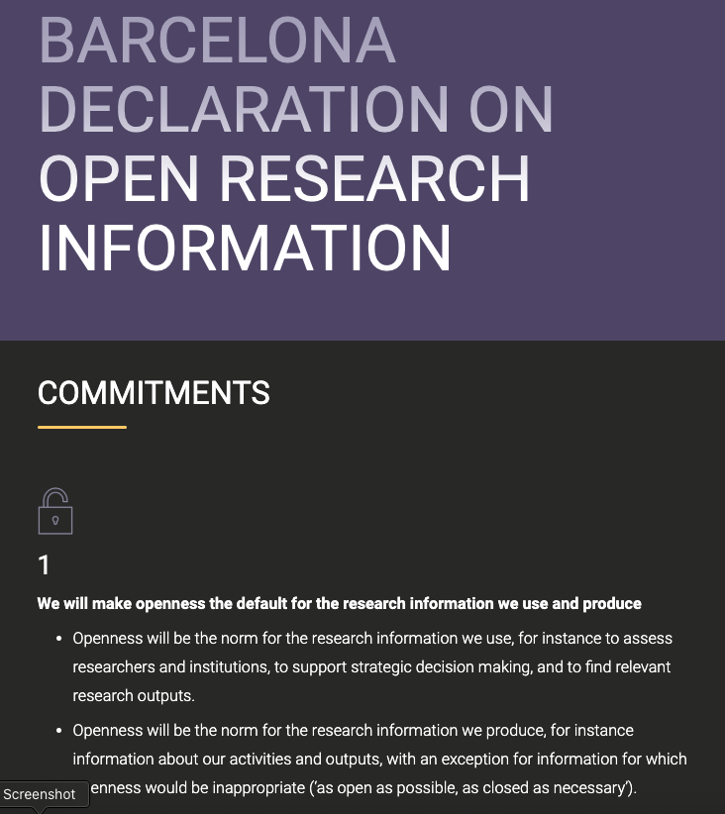
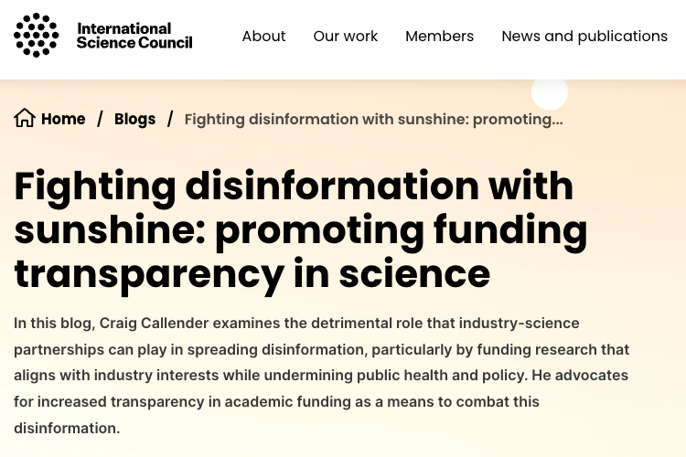
Calls for more open research information
https://council.science/blog/fighting-disinformation-with-sunshine-promoting-funding-transparency-in-science/
https://barcelona-declaration.org/commitments/

Slide 5

Calls for more open research information

Slide 6
Metadata in Crossref
Basic: titles, dates, author names, abstracts, DOI, location URL
Full-text URLs: e.g. for text-mining and Similarity Check
Crossmark: updates, retractions, corrections
Relationships: versions, translations, data, references, citation
Provenance: publisher/funder/steward information
Subject-specific: e.g. clinical trial info
Funding information: ROR/Funder Registry ID, award no/Grant DOIs
Contributor & Affiliations: ORCID iDs and ROR IDs preferred
Notes:
Our members are owners and stewards of their records.
Affiliations, funding and provenance metadata, as well as post-publications updates (such as corrections and retractions) are key markers of trust in the metadata.
ROR IDs are persistent identifiers for research institutions, that enable unambiguous identification of research performing organisations and more recently - also funders (ROR stands for Research Organization Registry)
ORCID is a free, unique, persistent identifier (PID) for individuals to use as they engage in research, scholarship, and innovation activities
References are a cornerstone of discoverability. We strongly encourage our membres to include references in the metadata and since June 2022 reference metadata has become open and accessible freely in our API.

Slide 7
Metadata in Crossref
- continued
Abstracts
Relationships: software, peer reviews
Licence information
Dates of publication and acceptance
Coming soon:
Contributor roles
Data availability statements
Submission dates

Slide 8

Finding a balance
CC0 StockSnap
Notes:
There’s a point in every meeting where someone says that “this is all about finding the balance”
Here I’m going to make this point on slide 7 :)
To build a robust, broad network of connections in the Research Nexus - the first step is to encourage many diverse organisations that participate in research communications to join and register their content.
We keep our barriers to entry low – required metadata is very basic, however reference linking is one of the member obligations.
It may not be perfect but it’s included.
This allows us to include more scholarly outputs in the overall record, while keeping the opportunity to help improve metadata and connections overtime.
We encourage, up-skill, provide support, and collaborate on initiatives that further encourage rich metadata.
We’re delighted with the approach taken by the SCOAP3 project, which creates a clear business case for publishers to take good care of the completeness and quality of their metadata.

Slide 9
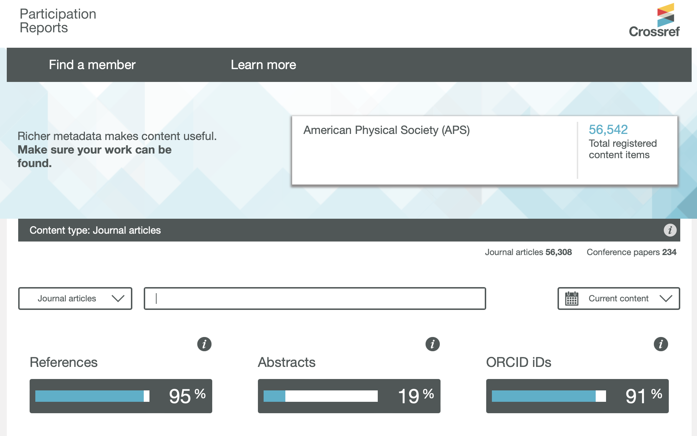
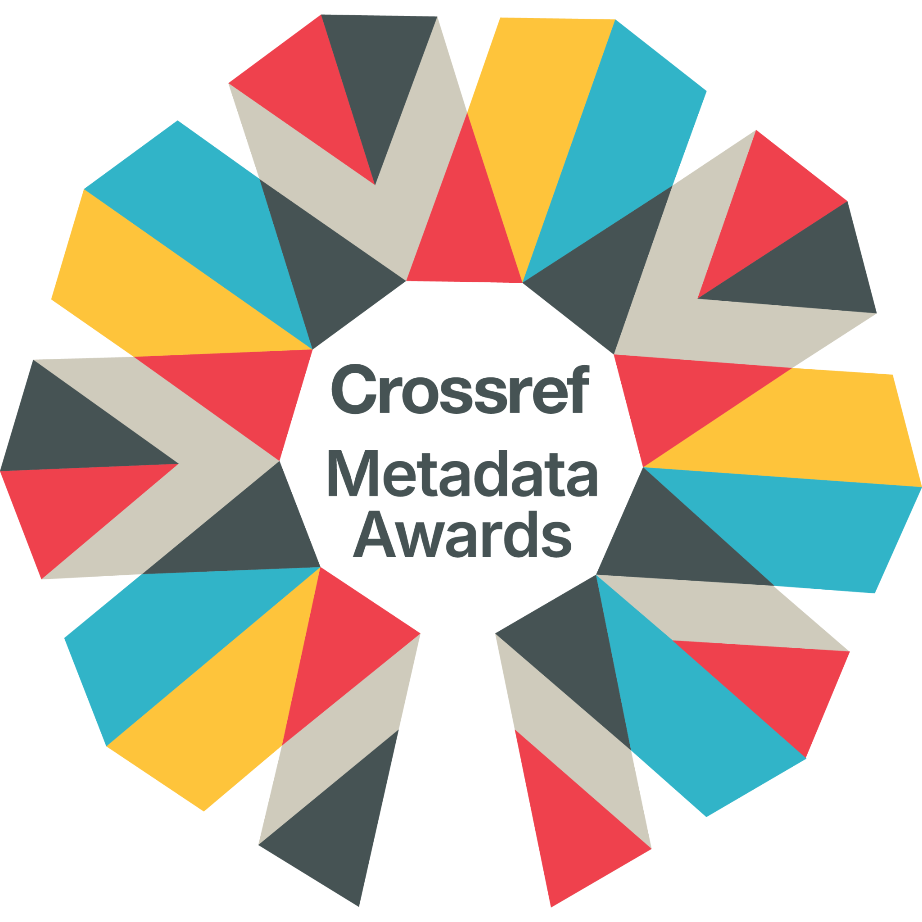
Improving metadata
Notes:
The report is a self-reporting tool our members can use to see the coverage of metadata for their records and identify gaps that can be acted upon. They can also see how others (their partners or competitors) are doing.
11 elements: References, Abstracts, ORCID IDs, Affiliates, ROR IDs, Funders Registry IDs, Funding award numbers, Crossmark, Text mining URLs, Licence URLs, and finally the SimilarityCheck URLs
In 2024 we launched a series of on-line drop-ins where we explain to members the importance of each of these elements how their participation.
On the basis coverage of these elements, earlier this year we awarded the first Crossref Metadata Awards for organisations who excel in metadata, and those that made the biggest improvements. Perhaps in the next edition SCOAP3 publishers will also be recognised in this way?
A few years ago now, Crossref collaborated with advocates of open, high quality metadata to create resources for stakeholders across the industry as part of the Metadata 20/20 project.
More recently, we collaborated with OASPA, DOAJ and COPE, to create resources for new publishers, to help everyone understand the best practices and standards of the industry: The PLACE.
This July, updated membership terms will come into effect - the changes seek to offer clarity around expected practices for out members.

Slide 10
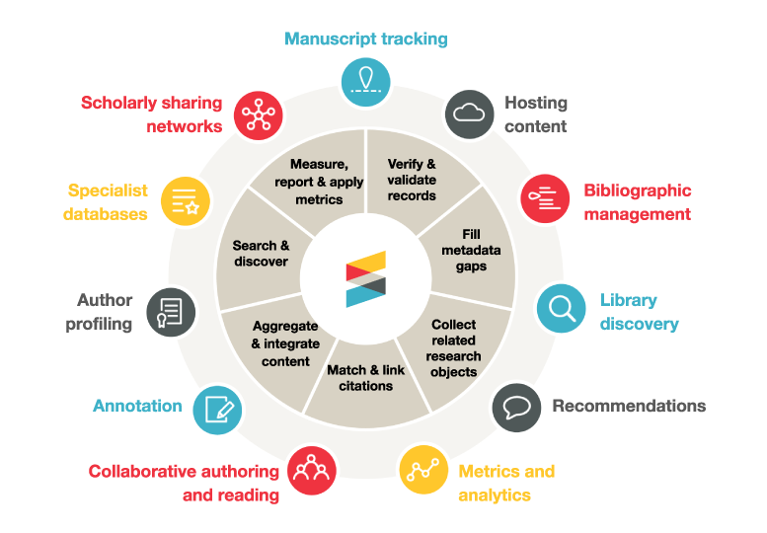
How is Crossref metadata used?
Notes:
Crossref metadata, created and stewarded by our members, is openly available and both human and machine interfaces facilitate access to it.
A network of services across the research ecosystem makes use of that open metadata

Slide 11
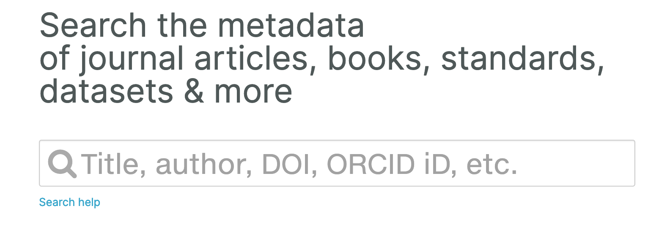
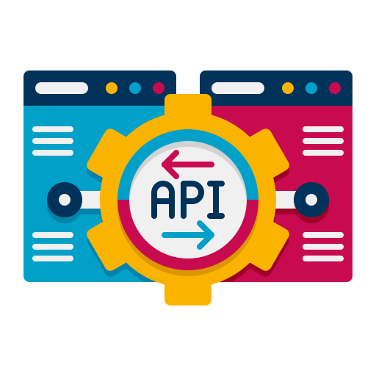
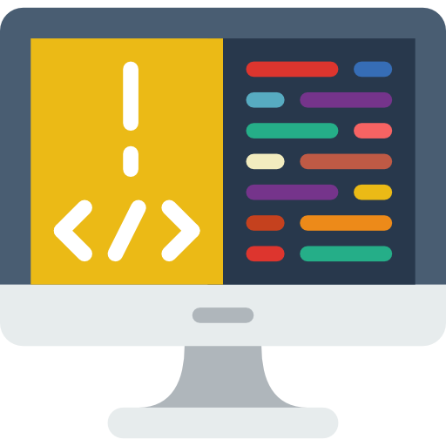
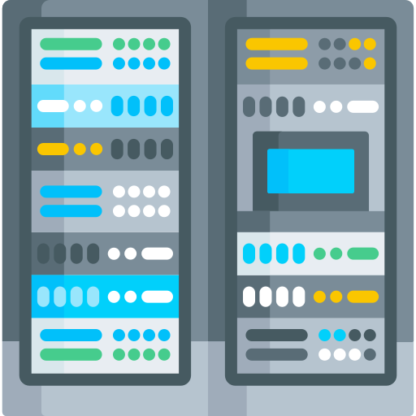
How you can use our metadata?
Metadata search
Crossref API
Public data files
Notes:
The search interface on our site allows to search for works and grants using bibliographic data.
We also have an option for everyone to preview how much of the key metadata elements our members register in the Participation Report.
An API is an Application Programming Interface.
Crossref API, a software intermediary that allows two applications to talk to each other, is integrated by many services - as mentioned on the previous slide. Some of these users require the use of our database at such a scale that they pay for a premium service access, Metadata Plus. This service also offers monthly snapshots of data.
While the API is designed primarily for machine use – more and more often people use it to query our database for research purposes too.
To facilitate learning about our REST API, we created an API Learning Hub.
[If time – Luis can give a demo]

Slide 12
Any questions?

Slide 13
Thank You
kora@crossref.org
‪@qornik.bsky.social‬

